Slide 1
Key Management
The distribution of public keys
The use of public-key encryption to distribute secret keys

Slide 2
Distribution of Public Keys
Public announcement
Publicly available directory
Public-key authority
Public-key certificates

Slide 3
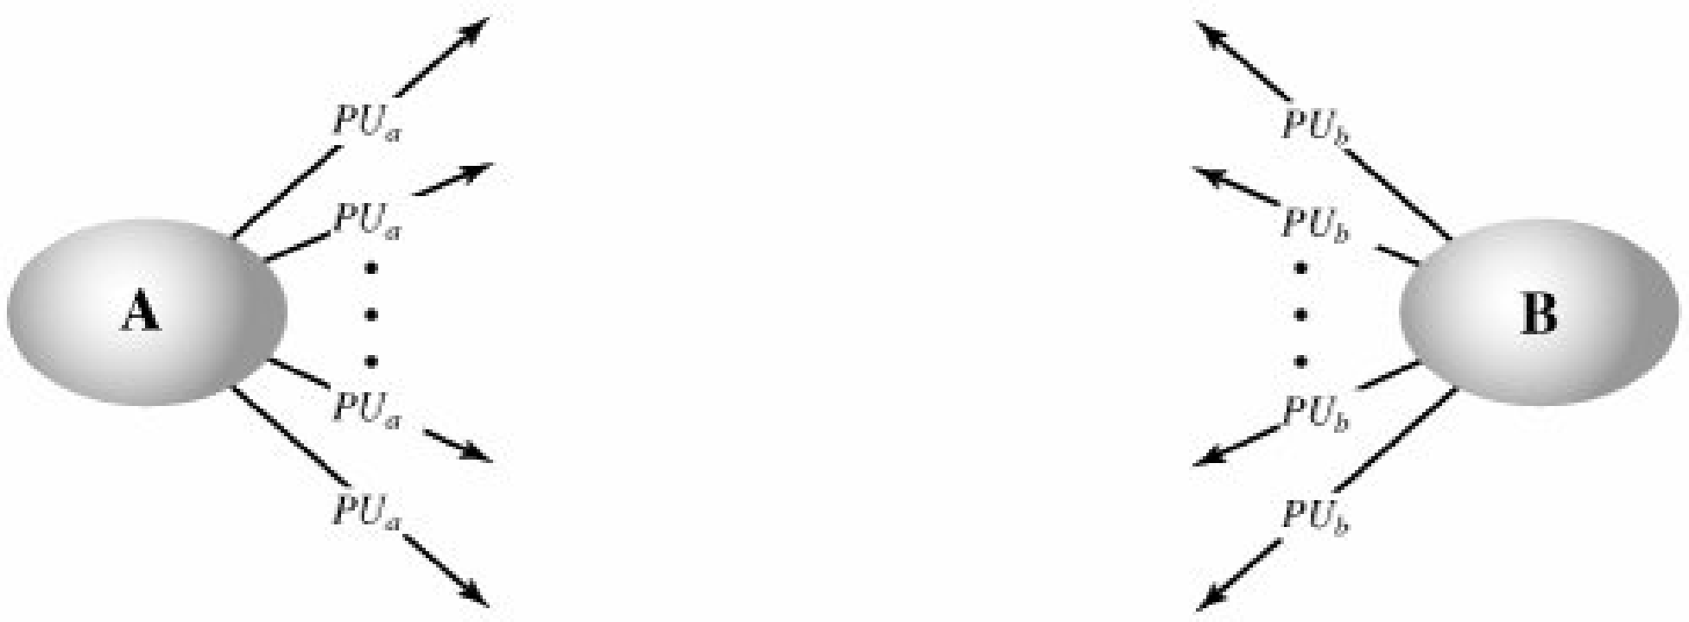
Public Announcement of Public Keys

Slide 4
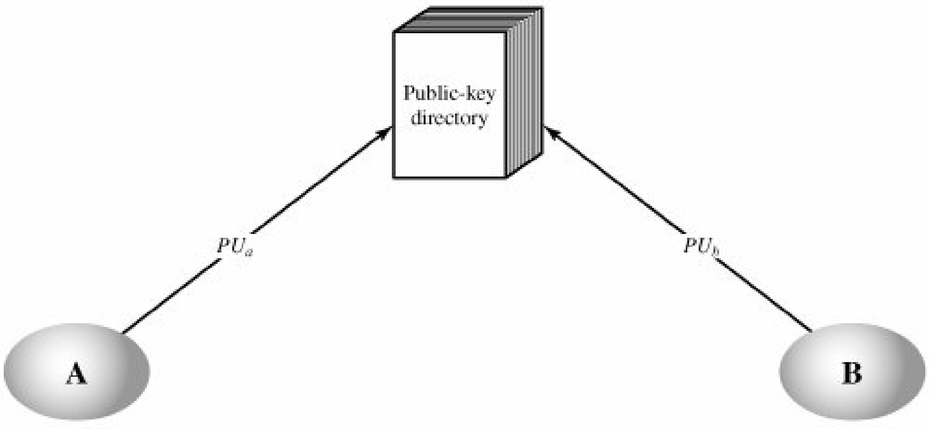
Publicly Available Directory

Slide 5
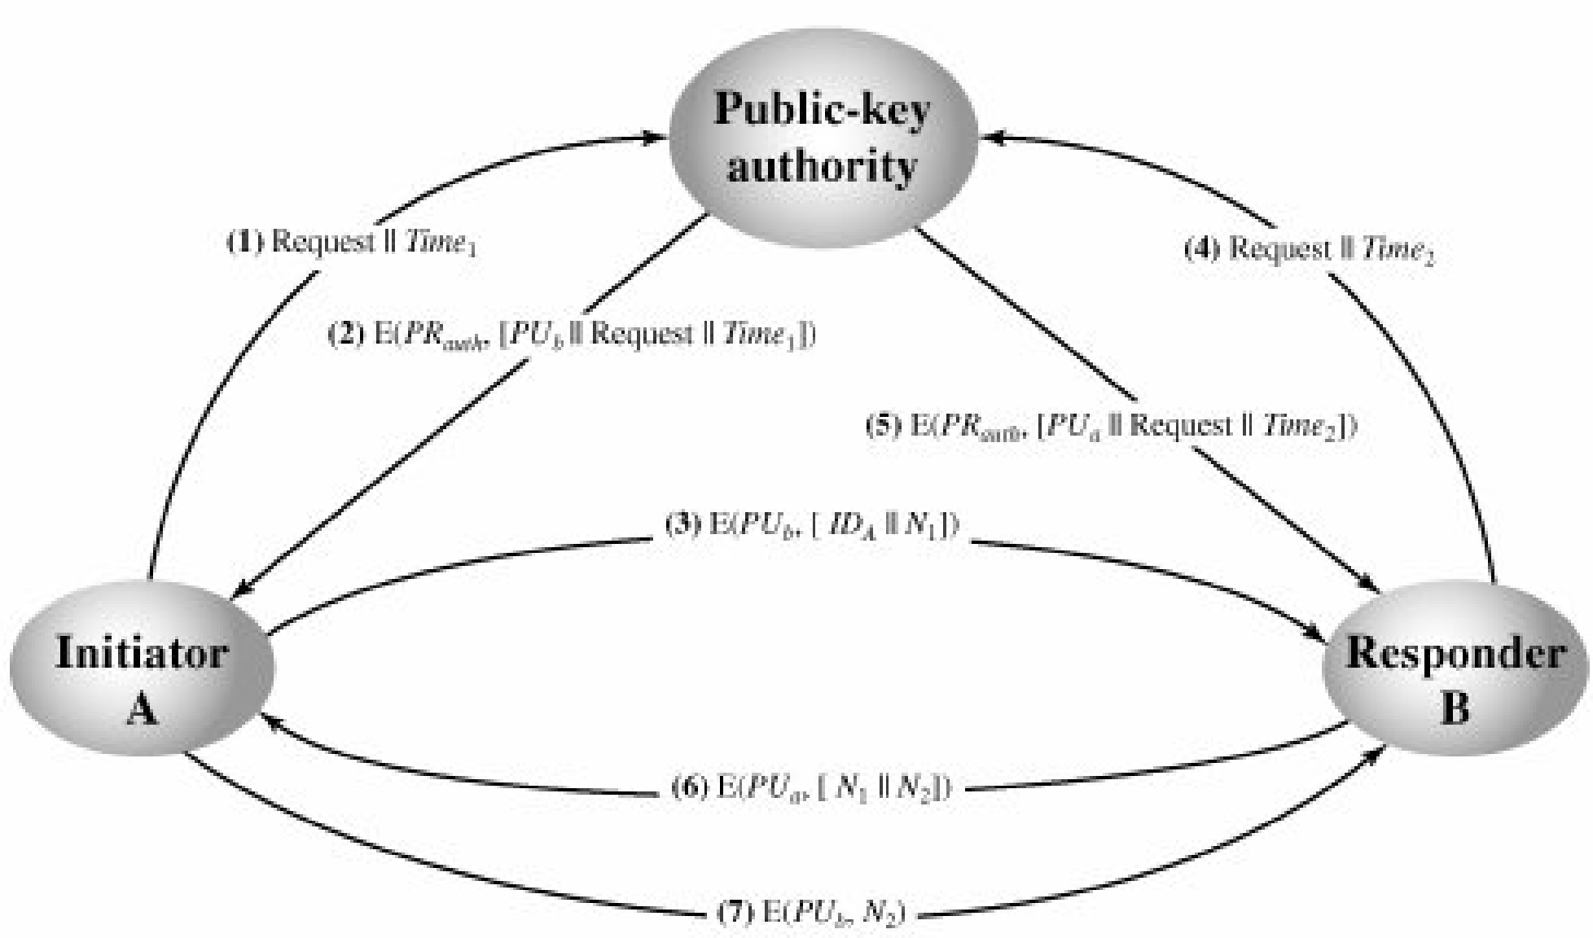
Public-Key Authority

Slide 6
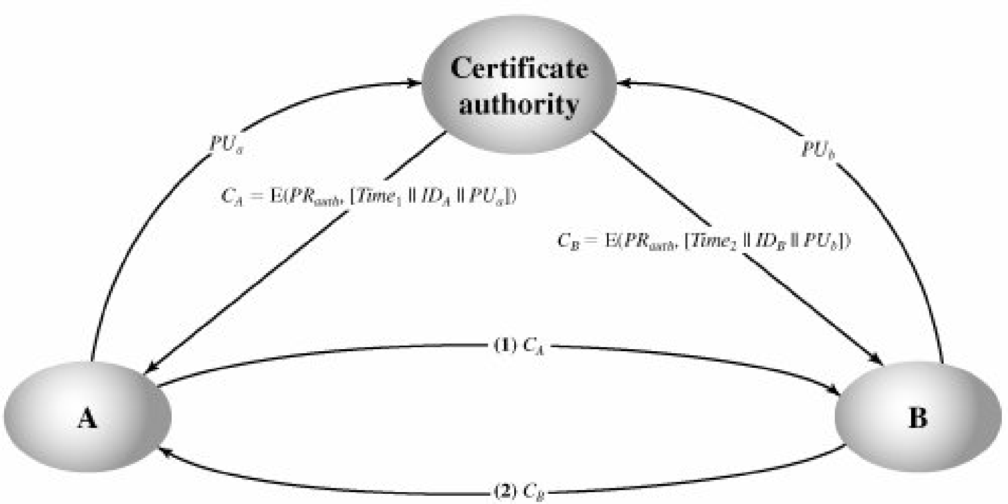
Public-Key Certificates

Slide 7
Diffie-Hellman Key Exchange
The purpose of the algorithm is to enable two users to securely exchange a key that can then be used for subsequent encryption of messages.
The algorithm itself is limited to the exchange of secret values

Slide 8
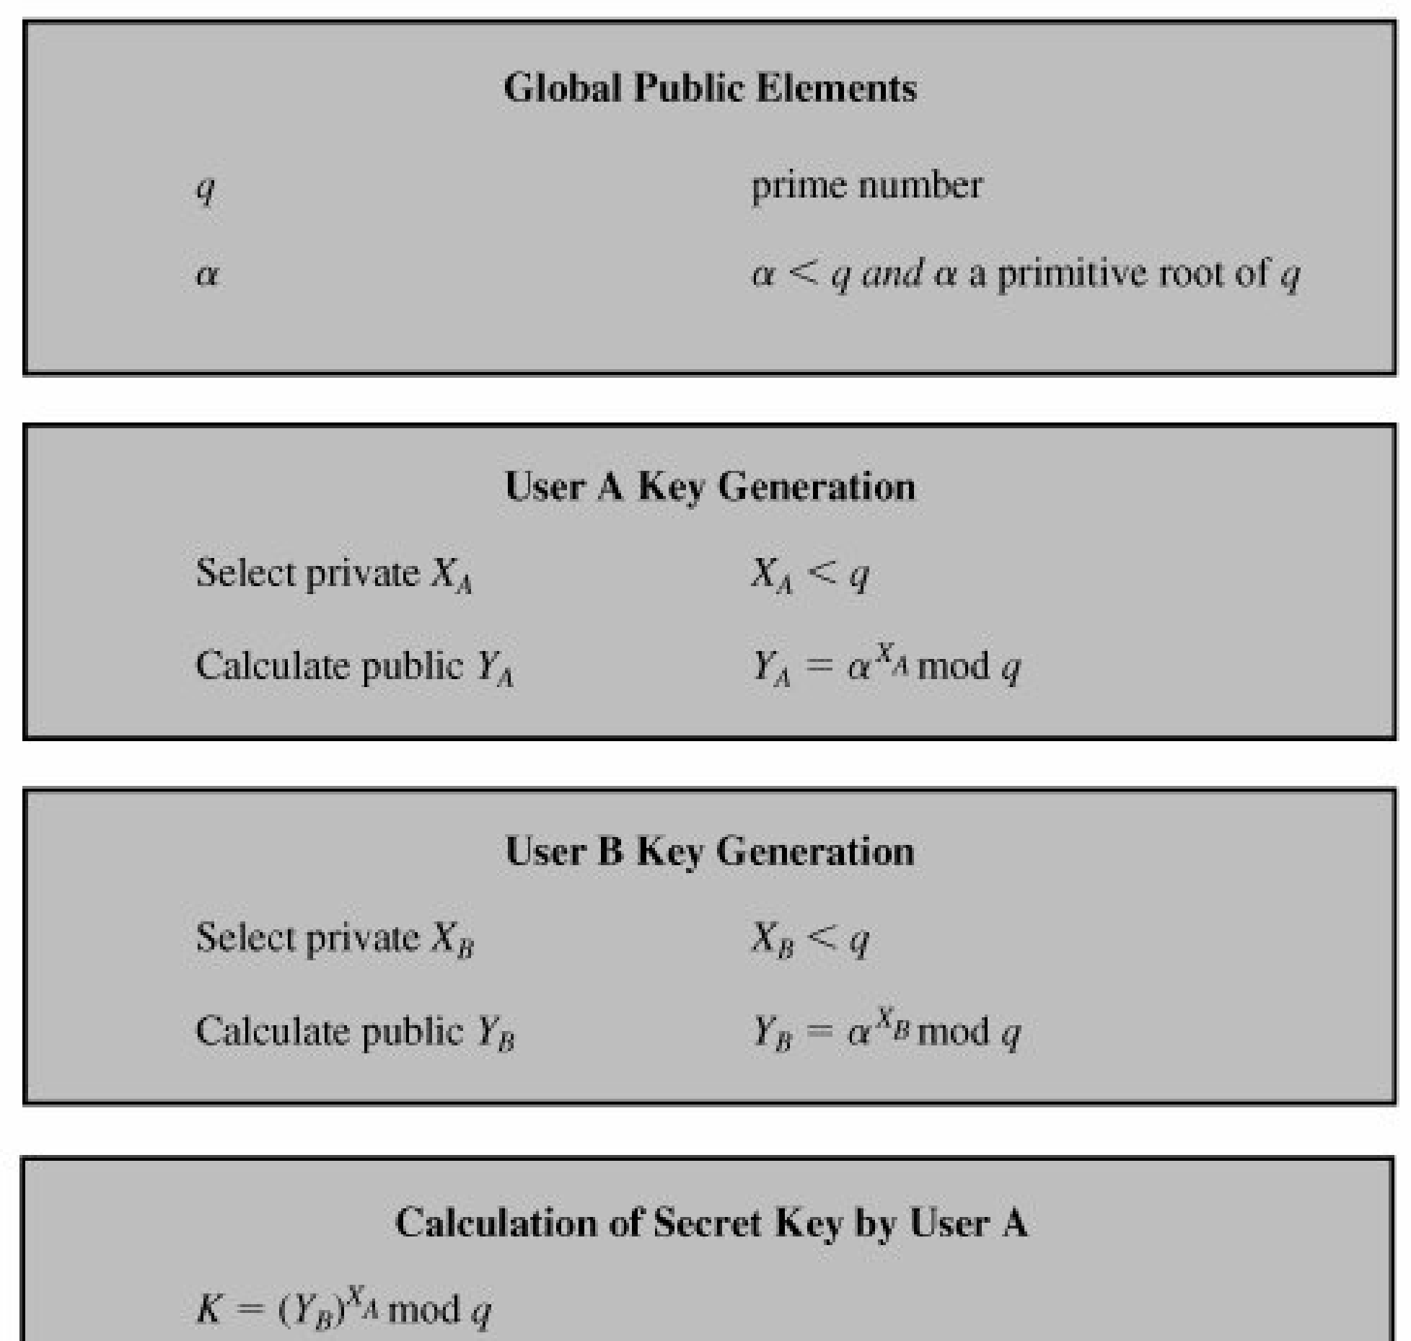
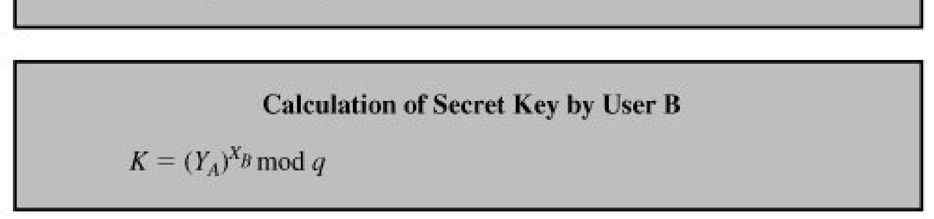

Slide 9
Esoteric Protocols

Slide 10
Secure Elections
Ideal voting protocol has at least following six properties
  Only authorized voters can vote
  No one can vote more than once
  No one can determine who voted for whom
  No one can duplicate anyone else’s vote
  No one can change anyone else’s vote without being discovered
  Every voter can make sure that his vote has been taken into account in the final tabulation
Additionally
7. Everyone knows who voted and who did not

Slide 11
Simplistic Voting Protocol #1
Each voter encrypts his vote with the public key of a Central Tabulating Facility (CTF)
Each voter sends his vote in to the CTF
The CTF decrypts the votes, tabulates, and makes the results public

Slide 12
Simplistic Voting Protocol #2
Each voter signs his vote with his private key
Each voter encrypts his signed vote with the CTF’s public key
Each voter sends his vote to a CTF
CTF decrypts the votes, checks the signatures, tabulates the votes, and makes the results public

Slide 13
Voting with Two Central Facilities
The following protocol uses a Central Legitimization Agency (CLA) to certify voters and a separate CTF to count votes
  Each voter sends a message to CLA asking for a validation number
  CLA sends the voter back a random validation number. CLA keeps a list of validation numbers and a list of their recipients to prevent multiple voting
  CLA sends the list of validation numbers to CTF
  Each voter chooses a random identification number. He creates a message with that number, the validation number he received from CLA, and his vote. He sends this message to CTF
  CTF checks the validation number against its list it received from CLA in step (3), If found, CTF crosses it off to prevent someone from voting twice. CTF adds the identification number to the list of people who voted for a particular candidate and adds one to the tally
  After all votes have been received, the CTF publishes the outcome, as well as the lists of identification numbers and for whom their owners voted

Slide 14
Improved Voting with a Single Central Facility
Satisfies first six requirements and the following two properties
  A voter can retract his vote and vote again within a given period of time
  If a voter finds out that his vote is miscounted, he can identify and correct the problem without jeopardizing the secrecy of his ballot

Slide 15
Protocol: Improved Voting with a Single Central Facility
CTF publishes a list of all legitimate voters
Within a specific deadline, each voter tells CTF whether he intends to vote
CTF publishes a list of voters participating in the election
Each voter receives an identification number I
Each voter generates a public-key/private-key pair: k, d. If v is the vote, he generates the following message and sends it to CTF anonymously: I,E_{k}(I,v)
CTF acknowledges receipt of the vote by publishing: E_{k}(I,v)
Each voter sends the CTF: I,d
CTF decrypts the votes. At end of election, it publishes results and for each different vote, the list of all E_{k}(I,v) values that contained that vote
If a voter observes that his vote is not properly counted, he protests by sending CTF: I,E_{k}(I,v),d
If a voter wants to change his vote from v to v’, he sends CTF: I, E_{k}(I,v’),d

Slide 16
Key Escrow
Key escrow is a cryptographic key exchange process in which a key is held in escrow, or stored, by a third party. A key that is lost or compromised by its original user(s) may be used to decrypt encrypted material, allowing restoration of the original material to its unencrypted state.

Slide 17
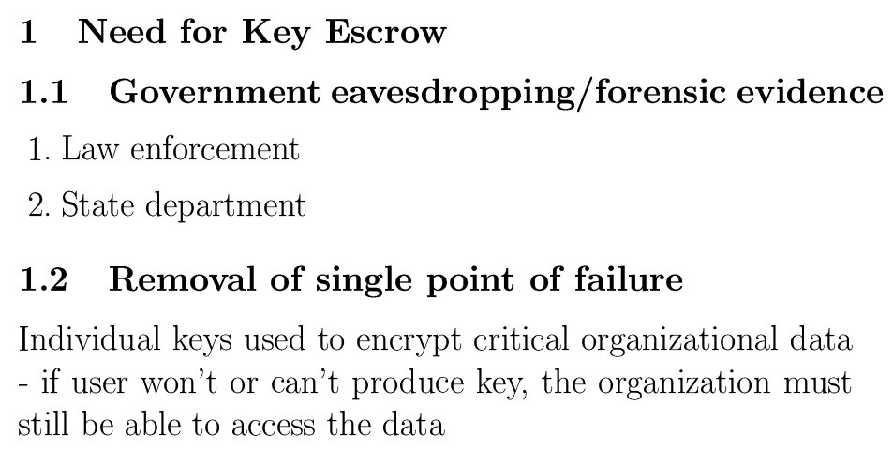

Slide 18
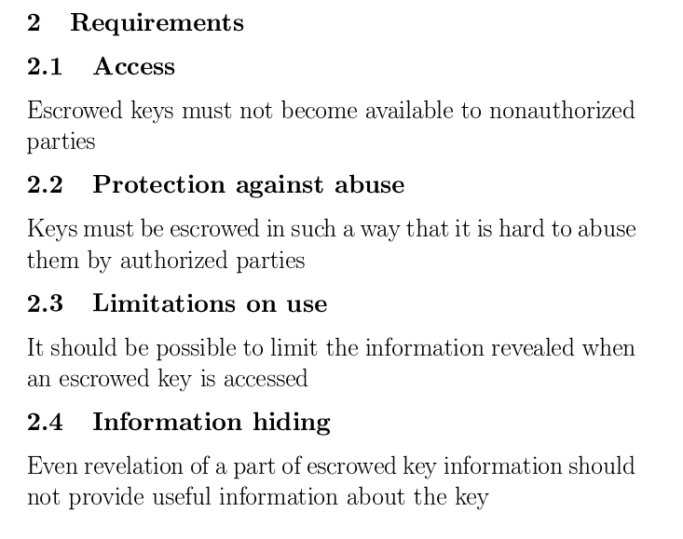

Slide 19
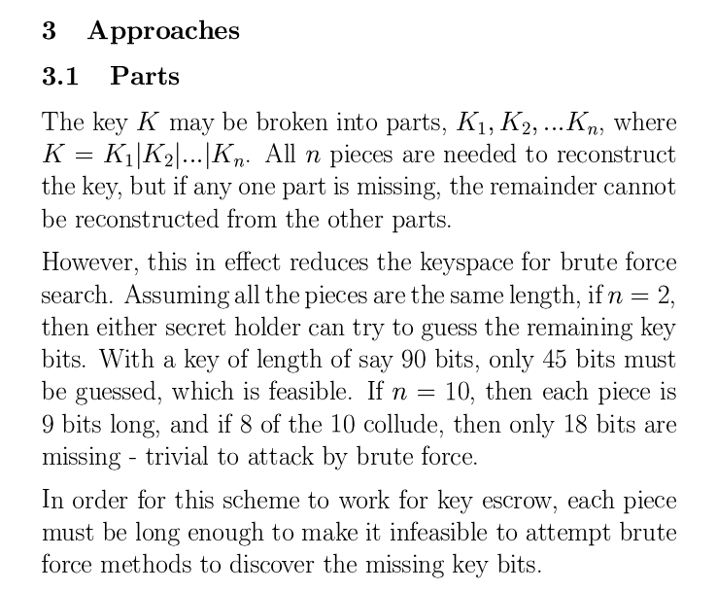

Slide 20
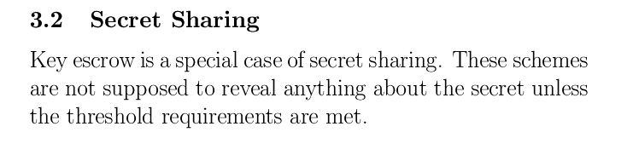

Slide 21
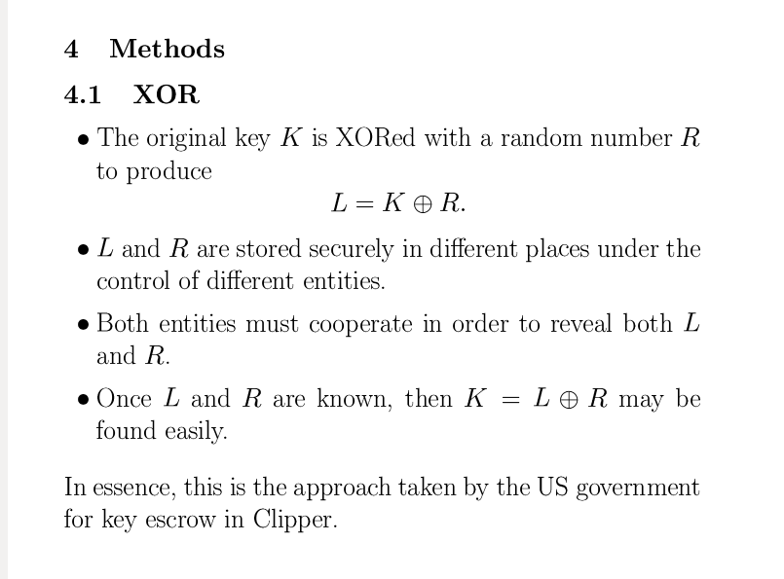

Slide 22
